Slide 1
Share Hope
Shaheer Arshad(2020-CS-639)
M. Abdullah(2020-CS-627)
Abdul Rehman(2020-CS-640)

Slide 2

Project overview
The product:
Donation app to help the needies get the donations in hand directly from donors and donors being satisfied to know they are donating the right way.
Project duration:
4-5 weeks

Slide 3
Project overview
The problem:
Helping the needy people to get donations directly from donors and helping donors to donate at the right place.
The goal:
Helping the needies for their life.

Slide 4
Project overview
My role:
UI/UX creator
Responsibilities:
User research, Wireframing, Prototyping.

Slide 5
User research
Personas
Problem statements
User journey maps
Understanding
the user

Slide 6
User research: summary
It's a common observation in our daily lives that many people around us are in need of donations and support, but they often don't receive enough help to meet their needs due to various reasons such as lack of awareness, limited resources, or insufficient outreach efforts.

Slide 7
User research: pain points
1
2
3
Identifying the Needies
Ensurity of Donation
Getting the help
The Donors are to be ensured that they are donating the right person without having any third party involved who might not do the work as the donor intended.
Needies get the money direct in hand to fulfil their needs and have a relief from their worries.
It's essential to identify the target audience for the donations app and understand their needs and preferences to create a relevant and user-friendly app.

Slide 8
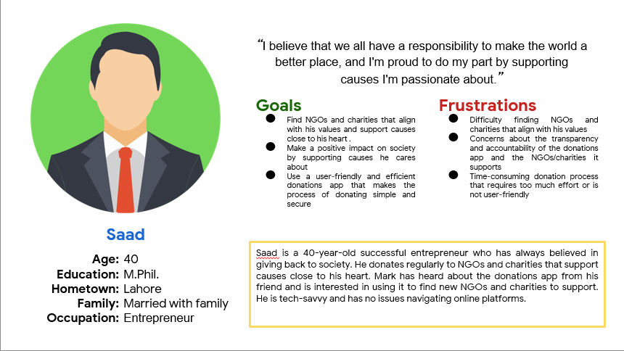
Persona: Saad
Problem statement:
Saad is an Enterprenure
who needs to donate to the poor because God has gifted him with wealth.

Slide 9
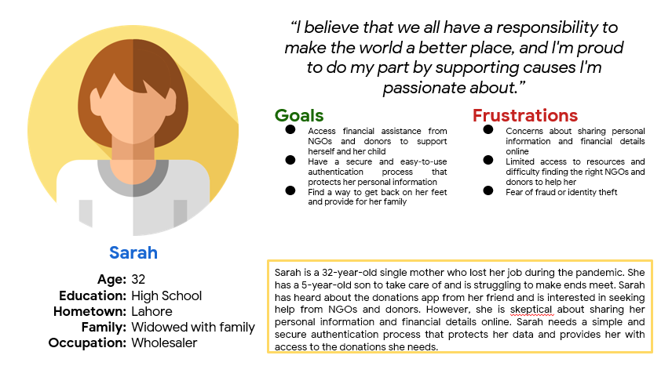
Persona: Sarah
Problem statement:
Sarah is a widow who needs help to raise her children because she solely cannot manage all the things after death of her husband.

Slide 10
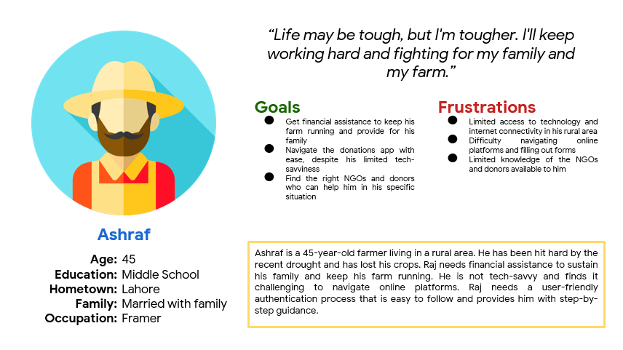
Persona: Ashraf
Problem statement:
Ashraf is a Farmer
who needs money to run his house because he lost his crops due to flood.

Slide 11
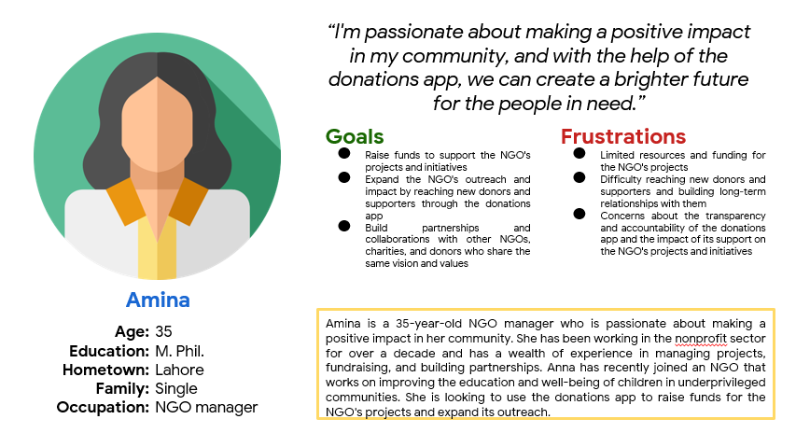
Persona: Saad
Problem statement:
Amina is a NGO Manager
who want to help the poor because she is a charity worker.

Slide 12
Paper wireframes
Digital wireframes
Low-fidelity prototype
Usability studies
Starting
the design

Slide 13
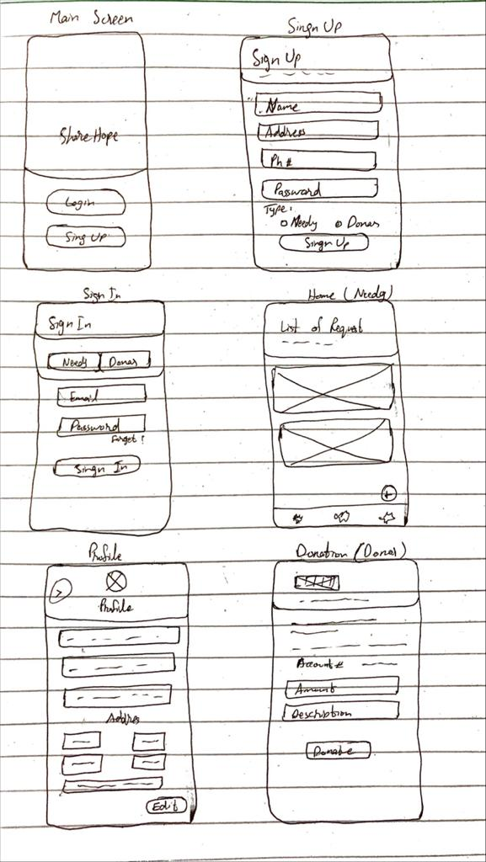
Paper wireframes
Designing an app that is easy to use and provide the user what he want. Allowing every step to be done in a few clicks.

Slide 14
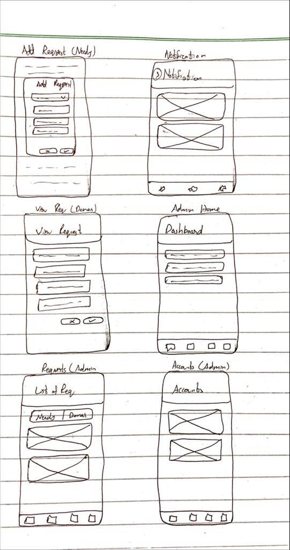
Paper wireframes
Designing an app that is easy to use and provide the user what he want. Allowing every step to be done in a few clicks.

Slide 15
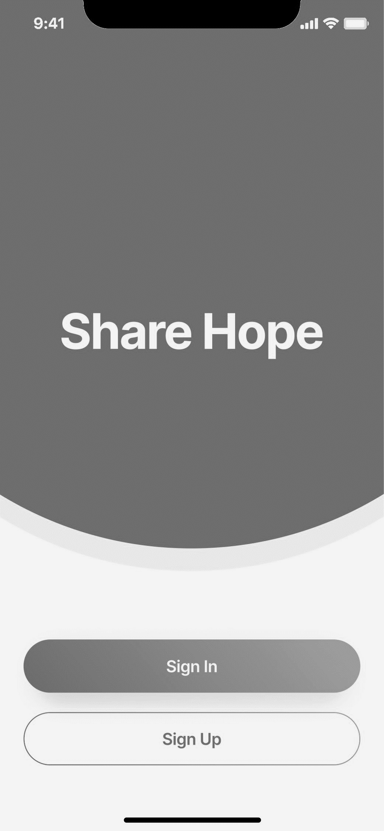
Digital wireframes
Allowing the user to interact firstly when the app opens.
App Name for user to know the app and branding.
Buttons for user to SignIn or SignUp

Slide 16
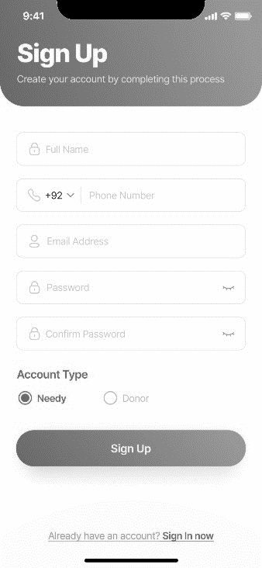
Digital wireframes
Page Title to let the user know which screen it is.
To let the user create account on th app using signup page.
Fields to fill information
SignUp Button to create account

Slide 17
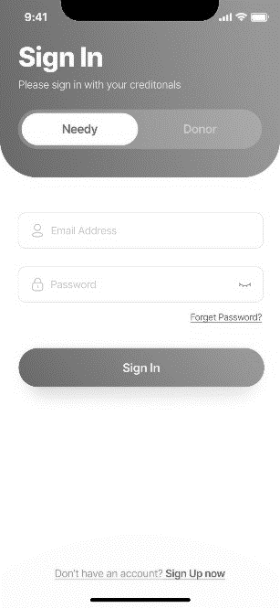
Digital wireframes
Page Title to let the user know which screen it is.
Let the user decide his role while using the app.
To let the user login to their respective account in the desired role.
Fields to fill information
SignIn Button to enter the account.

Slide 18
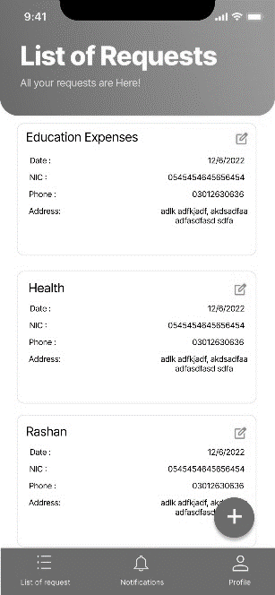
Digital wireframes
Page Title to let the user know which screen it is.
Button to edit request
To let the needy people to add or edit their requests.
Information of donation request.
Button to add new request.
Navigation Bar to switch pages.

Slide 19
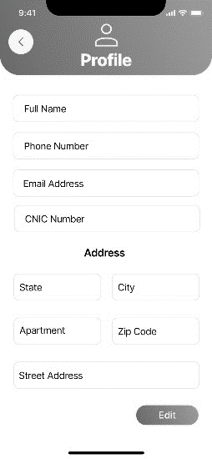
Digital wireframes
Page Title to let the user know which screen it is.
To let the user view or update their information.
Information of User.
Button to edit details.

Slide 20
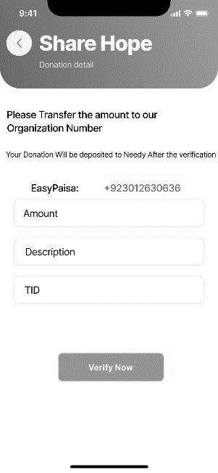
Digital wireframes
Page Title to let the user know which screen it is.
To let the donors make donations.
Information of donation request.
Button to confirm donation.

Slide 21
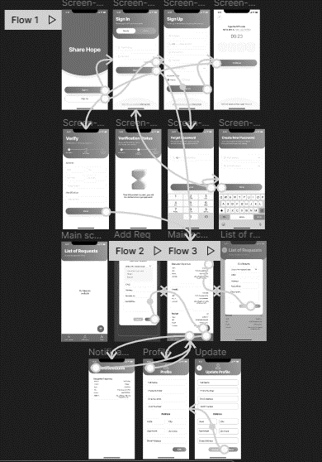
Low-fidelity prototype
Needy:
Signup > Verification Wait
SignIn > Forgrt Password > Create New > SignIn
SignIn > Home Screen > View Request / Edit Request / Add Request
SignIn > Home Screen > View Notification
SignIn > Home Screen > View/Edit Profile
Prototype link:
https://www.figma.com/proto/BLT3NhnzOGRMxuStbWt7lA/Share-Hope?node-id=1-2552&scaling=min-zoom&page-id=0%3A1&starting-point-node-id=1%3A2552

Slide 22
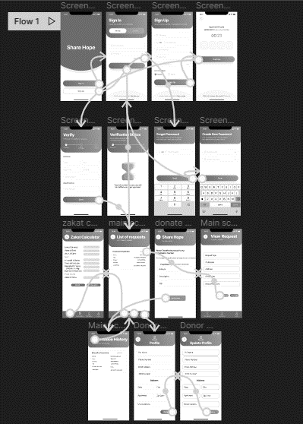
Low-fidelity prototype
Donors:
Signup > Verification Wait
SignIn > Forgrt Password > Create New > SignIn
SignIn > Home Screen > View Request > Donate
SignIn > Home Screen > View Donations
SignIn > Home Screen > View/Edit Profile
Prototype link:
https://www.figma.com/proto/iYEmMLKtSrVcy8hLubH764/Donor-Share-Hope?node-id=2-1706&scaling=min-zoom&page-id=0%3A1&starting-point-node-id=2%3A1706

Slide 23
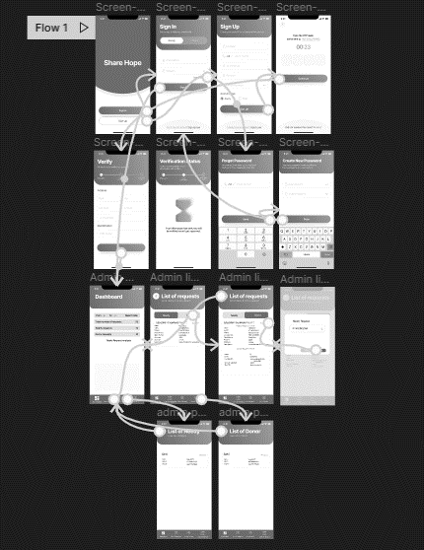
Low-fidelity prototype
Admin:
Signup > Verification Wait
SignIn > Forgrt Password > Create New > SignIn
SignIn > Home Screen > View Request > Verify
SignIn > Home Screen > View Donor
SignIn > Home Screen > View Needy
Prototype link:
https://www.figma.com/proto/qb1Ug008BmEdpYCV6WMK8U/Admin-Share-Hope?node-id=1-1877&scaling=min-zoom&page-id=0%3A1&starting-point-node-id=1%3A1877

Slide 24
Usability study: findings
The UI of app was consistent and can be improved in future to met with the requirements of users and the demand of change with time.
Round 1 findings
Round 2 findings
1
App UI can be more attractive
1
Confirm Donation can be done using aletbox.
2
Using a separate page for evrything isn’t nessasary.
2
Adding and editing request can be done using alertbox.
3
More attractive icon pack can be used.

Slide 25
Refining
the design
Mockups
High-fidelity prototype
Accessibility

Slide 26
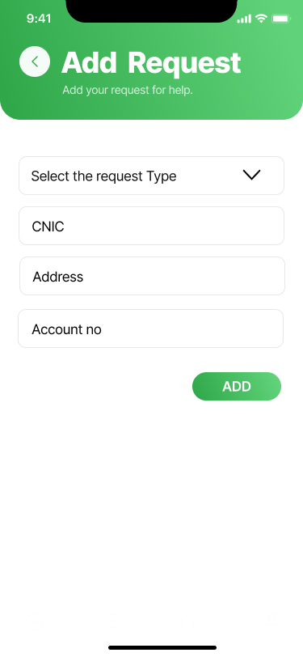
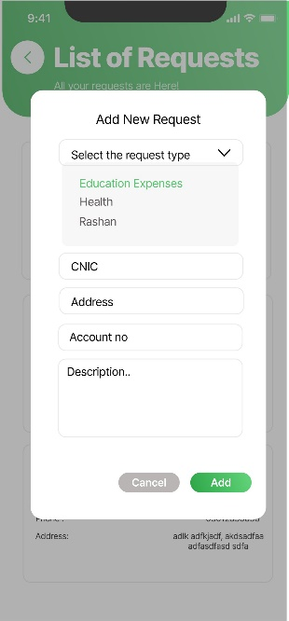
Mockups
Before usability study
After usability study
It is more easy and looks more modern using the alertbox for adding request.

Slide 27
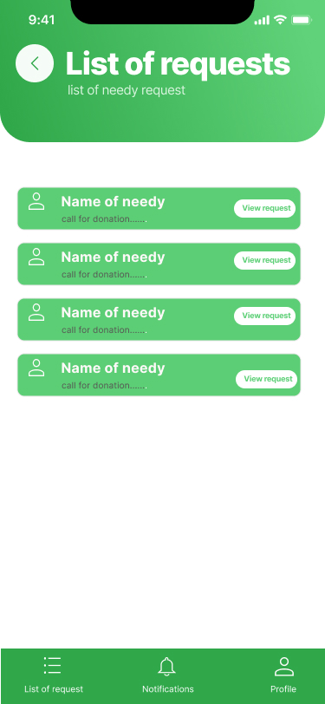
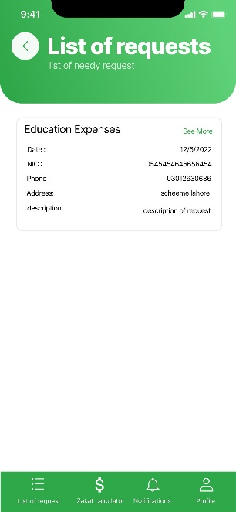
Mockups
Before usability study
After usability study
Providing necessary details of request in card is more appealing than adding another click to view the details.

Slide 28
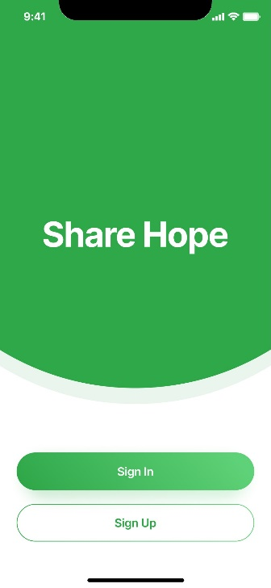
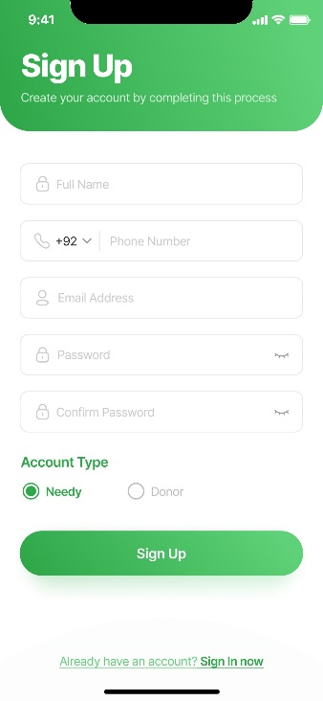
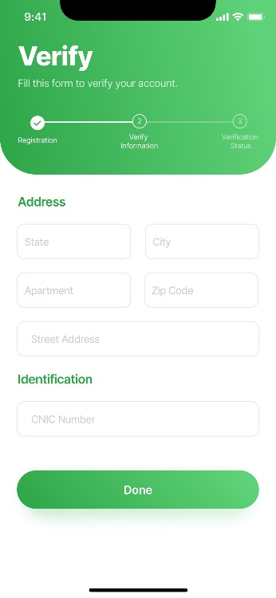
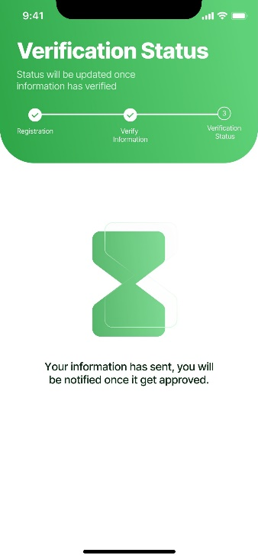
Mockups

Slide 29
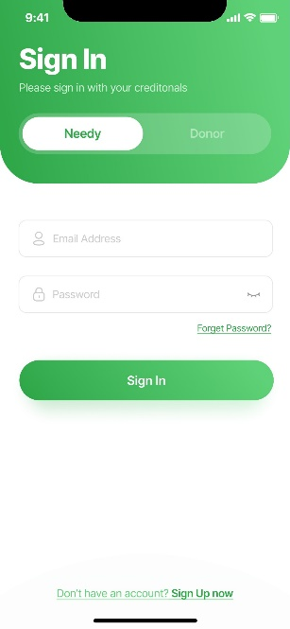
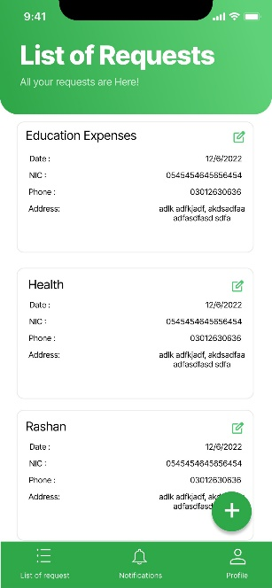
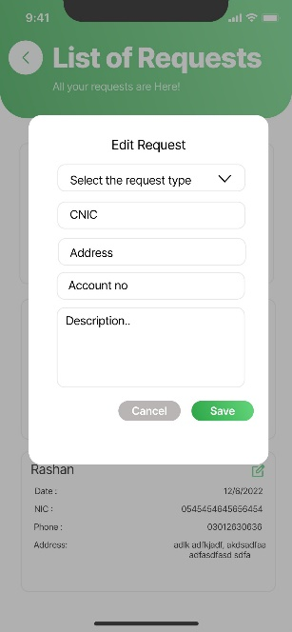
Mockups

Slide 30
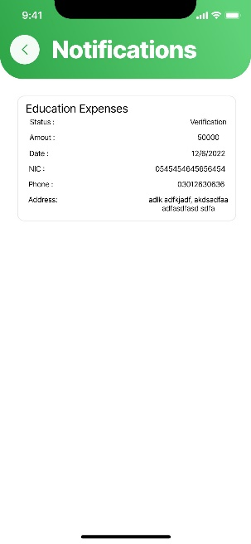
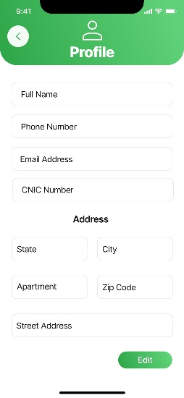
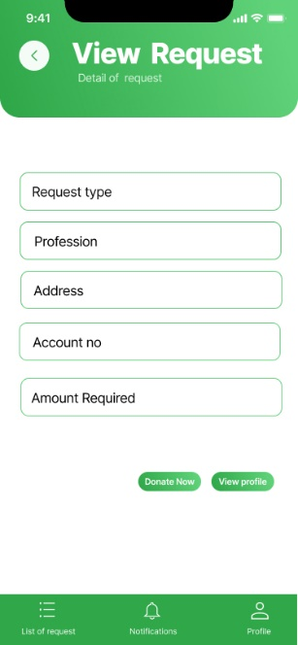
Mockups

Slide 31
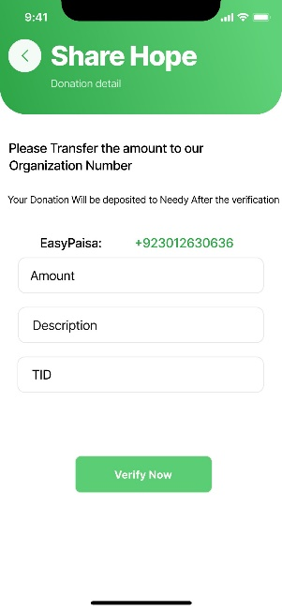
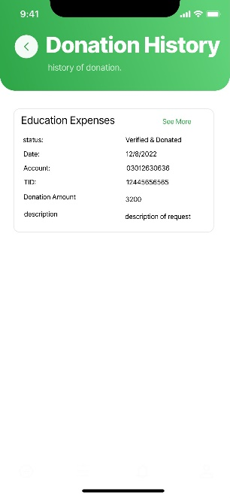
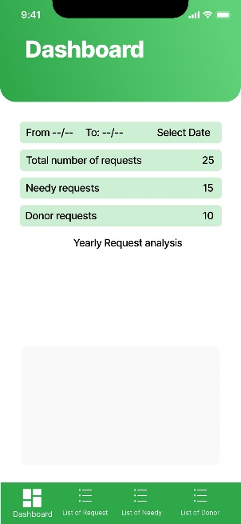
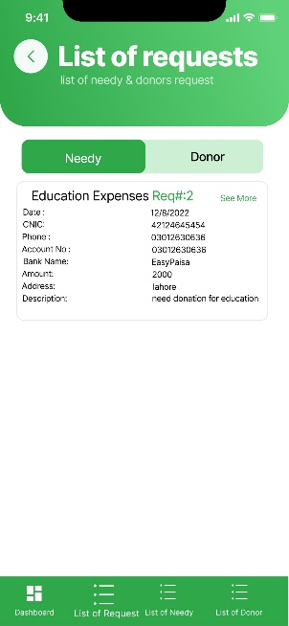
Mockups

Slide 32
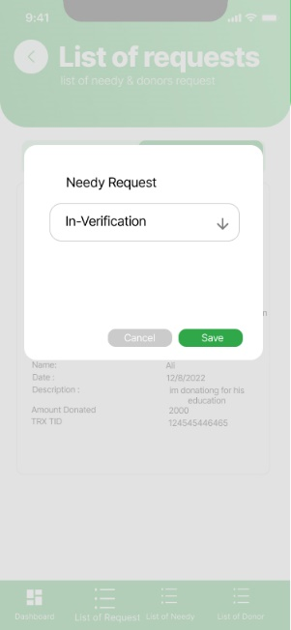
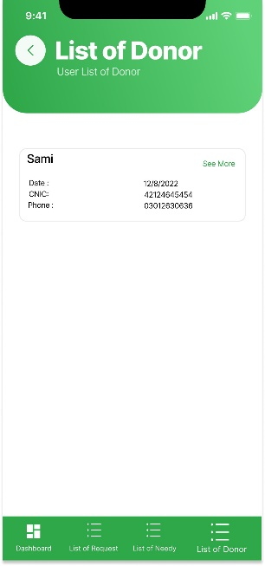

Mockups

Slide 33
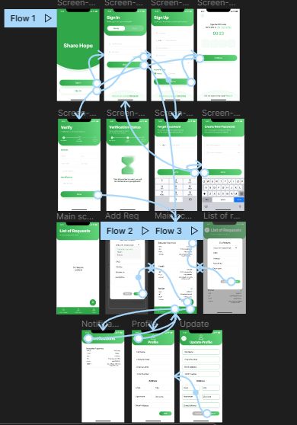
High-fidelity prototype
Needy:
Signup > Verification Wait
SignIn > Forgrt Password > Create New > SignIn
SignIn > Home Screen > View Request / Edit Request / Add Request
SignIn > Home Screen > View Notification
SignIn > Home Screen > View/Edit Profile
Prototype link:
https://www.figma.com/proto/BLT3NhnzOGRMxuStbWt7lA/Share-Hope?node-id=1-2552&scaling=min-zoom&page-id=0%3A1&starting-point-node-id=1%3A2552

Slide 34
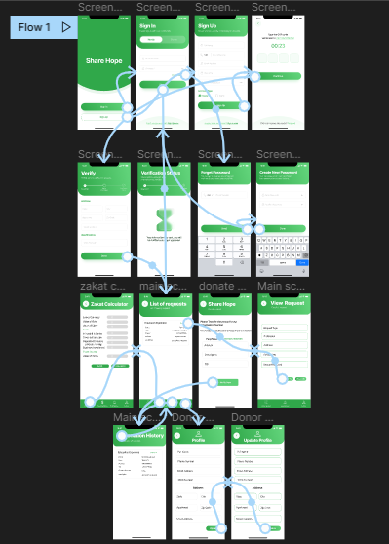
High-fidelity prototype
Donors:
Signup > Verification Wait
SignIn > Forgrt Password > Create New > SignIn
SignIn > Home Screen > View Request > Donate
SignIn > Home Screen > View Donations
SignIn > Home Screen > View/Edit Profile
Prototype link:
https://www.figma.com/proto/iYEmMLKtSrVcy8hLubH764/Donor-Share-Hope?node-id=2-1706&scaling=min-zoom&page-id=0%3A1&starting-point-node-id=2%3A1706

Slide 35
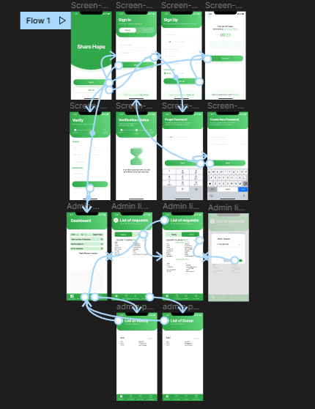
High-fidelity prototype
Admin:
Signup > Verification Wait
SignIn > Forgrt Password > Create New > SignIn
SignIn > Home Screen > View Request > Verify
SignIn > Home Screen > View Donor
SignIn > Home Screen > View Needy
Prototype link:
https://www.figma.com/proto/qb1Ug008BmEdpYCV6WMK8U/Admin-Share-Hope?node-id=1-1877&scaling=min-zoom&page-id=0%3A1&starting-point-node-id=1%3A1877

Slide 36
Going forward
Takeaways
Next steps

Slide 37
Takeaways
Impact:
According to a study participant, the new UI design for the donations app improved their user experience and made it easier for them to find and donate to causes they care about.
What I learned:
We have learned to create a design for app that is friendly to user and is easy to interact with.

Slide 38
Next steps
1
2
The next steps in this project would involve conducting further user testing and gathering feedback to continue improving the app's design and functionality.
Additionally, it would be necessary to collaborate with stakeholders, such as non-profit organizations and payment processors, to ensure that the app meets their needs and requirements.

Slide 39
Insert a few sentences summarizing the next steps you would take with this project and why. Feel free to organize next steps in a bullet point list.
Let’s connect!
Gmails
Shaheer Arshad: 2020cs639@student.uet.edu.pk
M. Abdullah: 2020cs627@student.uet.edu.pk
Abdul Rehman: 2020cs640@student.uet.edu.pk

Slide 40
Thank you!

